Slide 1
Interactive Quiz Web Application
TEAM MEMEBERS:
PRINCE KUMAR SINGH
PRIYANSHU SHUKLA
ANJANA M
GUIDED BY :
Prof. N Gayathri Mam

Slide 2
Introduction
The Quiz Web Application is an interactive platform designed to enhance learning by engaging users in quizzes on programming languages like Java, CSS, and JavaScript. It offers advanced features for an enriched user experience.
LINK FOR Website: https://clinquant-creponne-5c4a53.netlify.app/

Slide 3
Earlier Existing System
Current quiz systems include:
- Static quizzes without interactivity
- Limited user engagement
- Basic scoring mechanisms
Examples include general educational platforms and static test apps.

Slide 4
Drawbacks of Existing System
- Lack of advanced features like lifelines and hints
- No real-time scoring or personalized learning experience
- Limited user engagement due to static design

Slide 5
Proposed System
The Quiz Web Application provides:
- Timer-based quizzes for enhanced focus
- Lifeline (50-50) and hint system for user assistance
- Dynamic scoring and progress tracking
- Categorized quizzes for specific programming languages

Slide 6
Literature Survey
- Research on gamified learning and its impact on user engagement
- Existing quiz frameworks and their limitations
- Analysis of user requirements for an interactive quiz application
Chatgpt
Web help.

Slide 7
System Architecture
The application is divided into:
- Frontend: Developed using HTML ,CSS and Javascript for a user-friendly interface
- Backend: Servlets to handle logic JS for DOM Manipulation
- Features: Timer, lifelines, and scoring mechanism

Slide 8
System Diagrams
- Class Diagram: Represents the application's class structure
- ER Diagram: Depicts relationships between entities
- Data Flow Diagram: Visualizes the flow of data in the system

Slide 9
Features of the Web Application
- Timer-based quiz for each question
- 50-50 lifeline to remove two incorrect options
- Hint system to guide users
- Real-time scoring and answer summary at the end

Slide 10
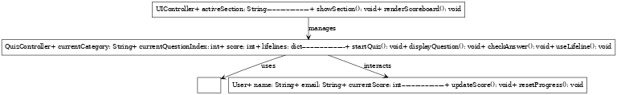

Slide 11
Technology Stack
Frontend Development
HTML: Used for structuring the web pages and creating various sections like Home, Category, Quiz, and Scoreboard.
CSS: Applied for styling, including custom animations, responsive design, and a gradient background.
Backend Development
Java Servlets: For managing the quiz logic, storing scores, and handling dynamic interactions.
Middleware
JavaScript: Used for interactivity, such as dynamic question loading, timers, lifelines, and transitions.

Slide 12
Conclusion
The Quiz Application is an innovative solution that bridges the gap between traditional quizzes and interactive learning. It offers a dynamic platform for users to enhance their programming skills. Future enhancements include multi-language support and integration with learning platforms.
The Web site is being Deployed under “Netlify.”

Slide 13
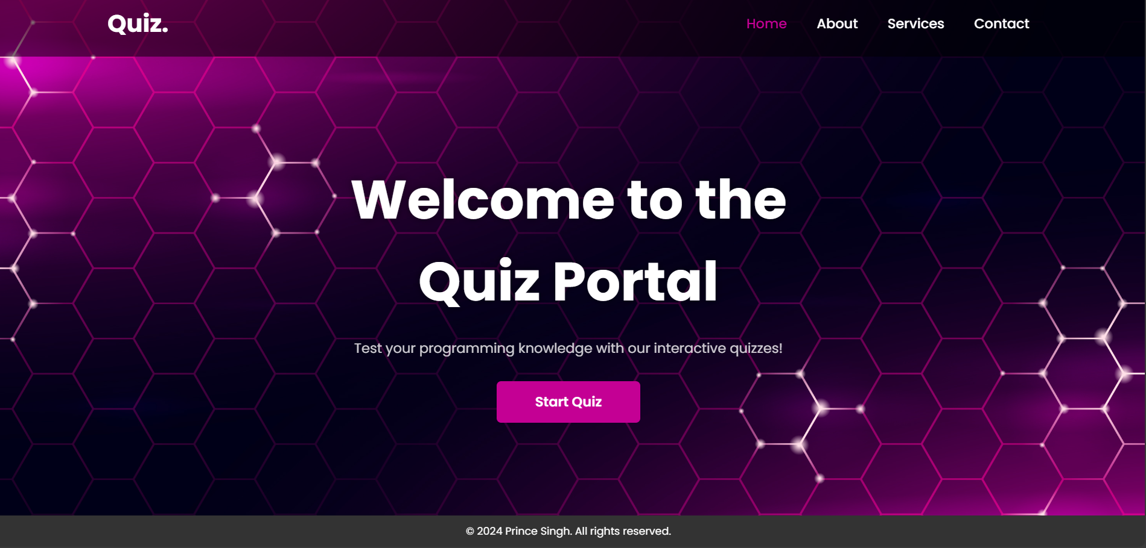

Slide 14
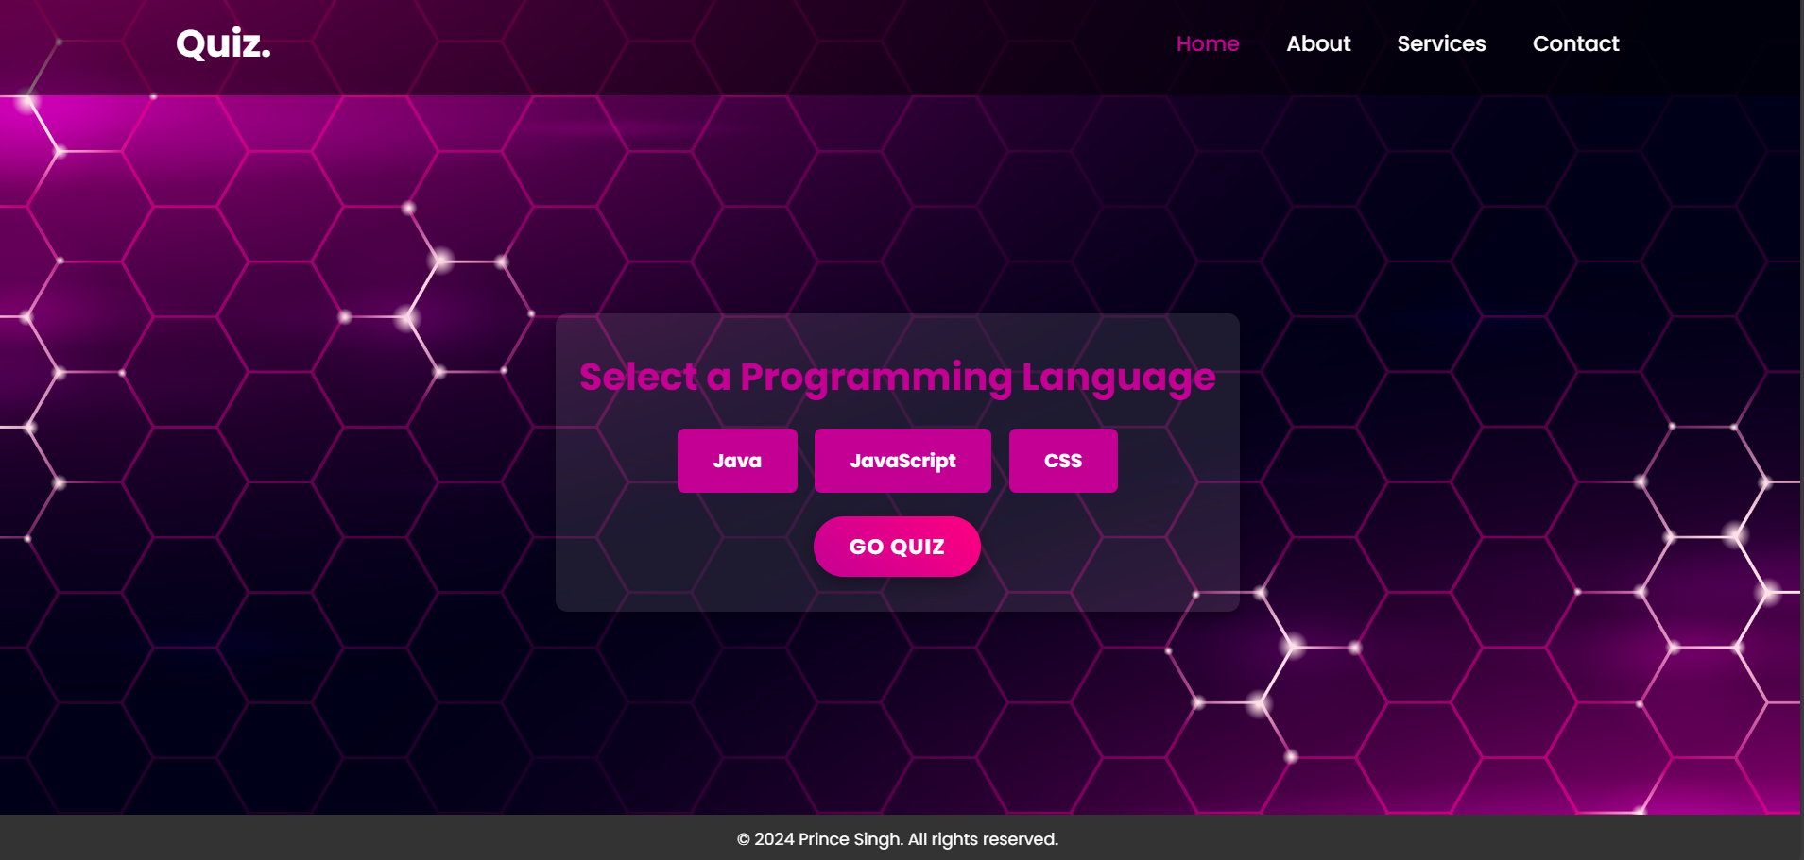

Slide 15
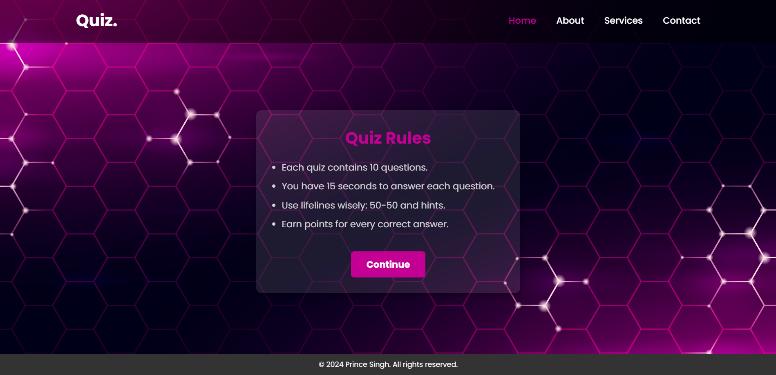

Slide 16
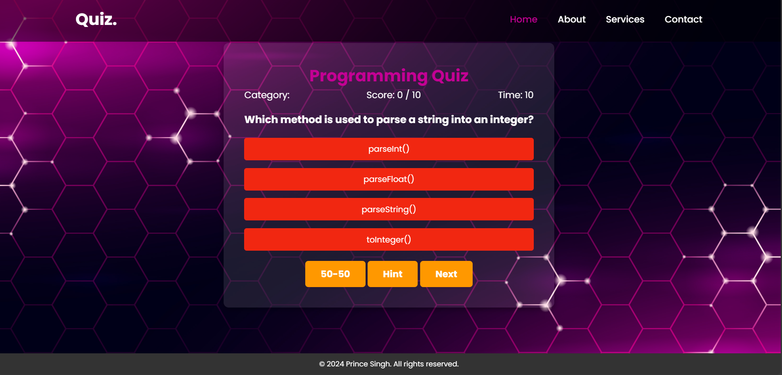

Slide 17
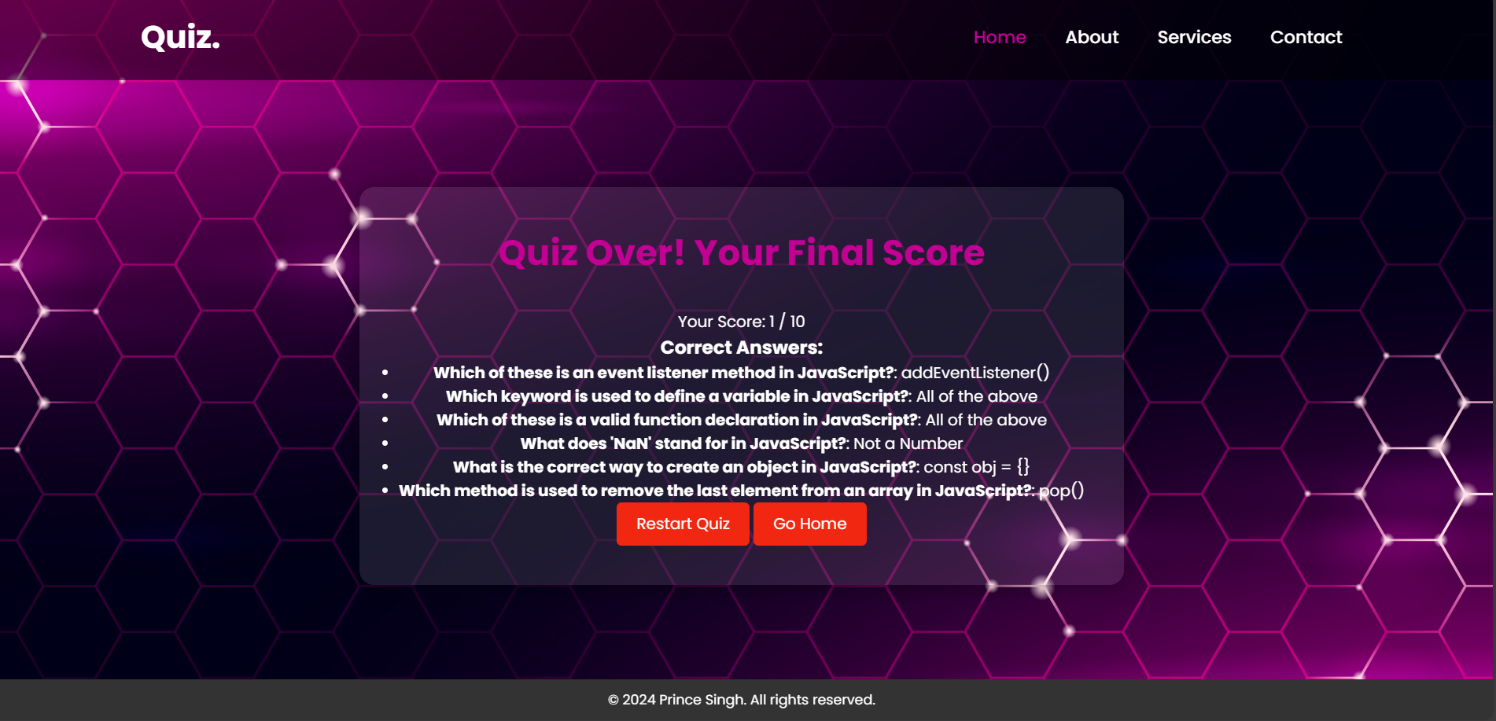

Slide 18
LINK FOR Deployed Website:
https://clinquant-creponne-5c4a53.netlify.app/

Slide 19
Thank You

